Slide 1



// PROJECT INTRODUCTION
PhishGuard
Email Phishing Detection System
A web-based system that scans emails, scores phishing risk from 0 to 100 and explains every verdict using machine learning, rules and real threat intelligence.
$ phishguard scan mail.eml
> checking 392,068 domains
> link host: 192.168.4.7 [IP]
> verdict: PHISHING
> risk score: 99 / 100
Machine learning
Threat intelligence
Explainable
PROJECT INCHARGE
Gathpa Srilatha Reddy Madam
TEAM MEMBERS
Vemula Nithin Murali 500477121
Sri Varshitha Gollapalli 500477127
Nidadavolu Vara laxmi 500477174
Kolguri Shirisha 500477128
Budime Ajay 500477976
01 / 30
Notes:
Introduce PhishGuard: an email phishing detection system that gives every email a 0-100 risk score and explains the verdict. The terminal card on the right shows a sample scan.

Slide 2




// 02 PROBLEM STATEMENT
Phishing is easy to launch and hard to spot
Phishing emails imitate trusted brands to steal passwords and money. Basic filters miss many of them and rarely explain why an email was flagged, so users cannot learn to spot the next one.
Deceptive links
Fake domains, raw IP addresses and shortened URLs hide the real destination.
Pressure tactics
Wording like "verify within 24 hours" pushes people to act before thinking.
HOW AN ATTACK WORKS
Fake email
Click link
Fake login
Data stolen
Opaque filters
A block or a pass with no explanation teaches the user nothing.
02 / 30
Notes:
Explain the problem: phishing works through disguised links, urgency and filters that give no explanation. The mini attack path shows how one click leads to stolen data.

Slide 3
// 03 OBJECTIVES
What the project sets out to achieve
Detect
Explain
1
2
Classify every email as Safe, Suspicious or Phishing.
Give a 0-100 score with plain-English reasons for each verdict.
Use real data
Remember and learn
3
4
Check links against a real phishing-domain database and train on real emails.
Store every scan and let users correct verdicts to retrain the model.
Be easy to use
Build awareness
5
6
Offer a web app, bulk CSV scanning and a REST API.
Help users practise spotting scams with live highlights and a quiz.
03 / 30
Notes:
Six objectives. Each one maps to a feature that is demonstrated later in the deck.

Slide 4
// 04 EXISTING VS PROPOSED
From a silent filter to an explainable detector
EXISTING (typical filters)
PROPOSED (PhishGuard)
Verdict
Block or pass, usually with no score
Risk score 0-100 with three verdicts
Detection basis
Keyword lists or static blocklists
ML model + rules + 392K-domain threat database
Explainability
Little or no reason shown
Plain-English reasons and highlighted warning signs
Records and access
Limited history, no open API
SQLite history, CSV export and REST API
Adaptation
Fixed rules, slow to update
Allow/block lists, feedback retraining, feed refresh
04 / 30
Notes:
Compare typical spam filters with PhishGuard row by row. Existing-system points describe typical filters in general, not any specific product.

Slide 5












// 05 SYSTEM ARCHITECTURE
How the pieces fit together
INPUT
FLASK SERVER
ANALYSIS ENGINE
SCORING
OUTPUT + STORE
Pasted email
Email parser (headers, links)
SQLite database
.eml upload
Text ML model
Dashboard
Routes
API-key auth
Live preview
Score
0-100
Safe / Suspicious / Phishing
CSV bulk scan
Rule engine
API response
REST API
Threat intelligence
Feedback loop
05 / 30
Notes:
Walk left to right: input, Flask server, the four-part analysis engine, scoring, then output. Every scan is stored in SQLite and the feedback loop retrains the model.

Slide 6





// 06 FEATURES
What PhishGuard can do
Multi-input scanning
Explainable verdicts
Real threat database
Live preview
Paste, .eml, CSV or API
0-100 score with clear reasons
392,068 known phishing domains
Score updates as you type
Warning highlighter
History and export
REST API
Learns from feedback
Marks risky links and words
SQLite records, CSV download
Key-protected scan endpoints
Retrain on your corrections
06 / 30
Notes:
Eight headline features. The live preview and highlighter make good live-demo moments.

Slide 7


// 07 DETECTION METHODOLOGY
Four layers work together
Text model
TF-IDF word pairs plus URL and urgency features feed a Logistic Regression classifier.
Probability 0-100%
Rule engine
Checks IP links, shorteners, lookalike domains, urgency words, spoofed senders and .eml header signals.
Rule points 0-100
Threat intelligence
Matches links against 392,068 known phishing domains; checks domain age and SPF/DMARC when online.
Hard flag + bonus
Your lists
Trusted domains lower the score; blocked domains force a phishing verdict.
Override
07 / 30
Notes:
Four layers. The model catches wording patterns, rules explain specific red flags, the threat database catches known-bad domains, and user lists let each person tune the result.

Slide 8
// 08 RISK SCORING MODEL
From signals to a single 0-100 score
OVERRIDES
FINAL SCORE
score = 0.5 x ML% + 0.5 x RULES
Rules 60 or more
score is at least 70
ML% is the model's phishing probability; RULES is the rule points (max 100).
Threat database hit
score is at least 97
Sample phishing email: 99
Safe
Suspicious
Phishing
Blocked domain
score is at least 98
0
35
60
100
Trusted domain
score capped at 10 (unless a threat hit)
LIVE CHECKS ADD POINTS (online)
Domain under 30 days old +30 | under 180 days +10 | sender without SPF/DMARC +10 | sender domain not found +25
Verdict: 60+ Phishing, 35-59 Suspicious, below 35 Safe
08 / 30
Notes:
The score blends the model and the rules equally. Strong evidence, such as a known phishing domain, overrides the blend. Verdict bands: 60 and above Phishing, 35 to 59 Suspicious, below 35 Safe.

Slide 9






// 09 TECHNOLOGY STACK AND EXTRAS
Built with a small, practical toolset
ALSO IN THE PROJECT
Model lab: 4 algorithms compared
Python 3
Flask
scikit-learn
Language
Web framework
ML library
Spot the phish quiz game
Bulk CSV scan with export
Printable scan reports
SQLite
HTML/CSS/JS
DNS + RDAP
Dark mode, drag-and-drop .eml
Database
Frontend
Live lookups
Update threat feed from internet
Data: Phishing.Database feed (392,068 domains) + Enron-Spam sample (5,000 real emails)
09 / 30
Notes:
The stack is deliberately small: Python, Flask, scikit-learn and SQLite. The right-hand list covers extra features beyond core detection.

Slide 10



// 10 IMPLEMENTATION AND USER FLOW
From opening the app to retraining the model
Open app
Paste or upload
Live preview
Scan
Review
Feedback
Dashboard
text, .eml, CSV
score as you type
model + rules + threat DB
score, reasons, highlights
mark right or wrong
IMPLEMENTATION: FIVE MODULES
app.py
detector.py
intel.py
db.py
templates/
Flask routes, REST API and API-key auth
Features, ML model, rules, .eml parsing
Threat feed, domain age, SPF/DMARC
SQLite history, lists and settings
Dashboard, scan, history, quiz, model lab
10 / 30
Notes:
Top row is what the user does. The bottom row is how it is built: five modules, each with one job.

Slide 11
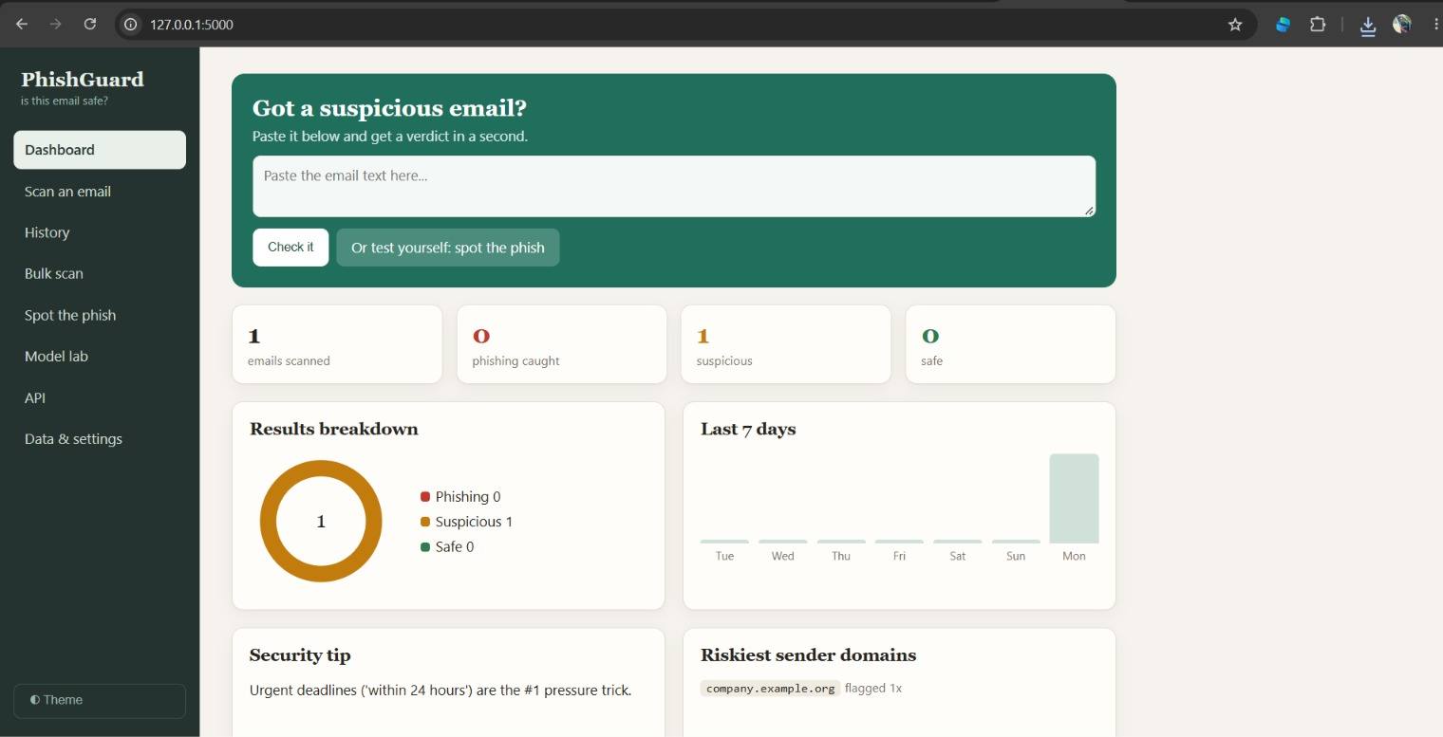
Fig. 1 — Dashboard (top): Dashboard with quick email check input, telemetry cards, and results breakdown
11 / 30
Notes:
Top row is what the user does. The bottom row is how it is built: five modules, each with one job.

Slide 12
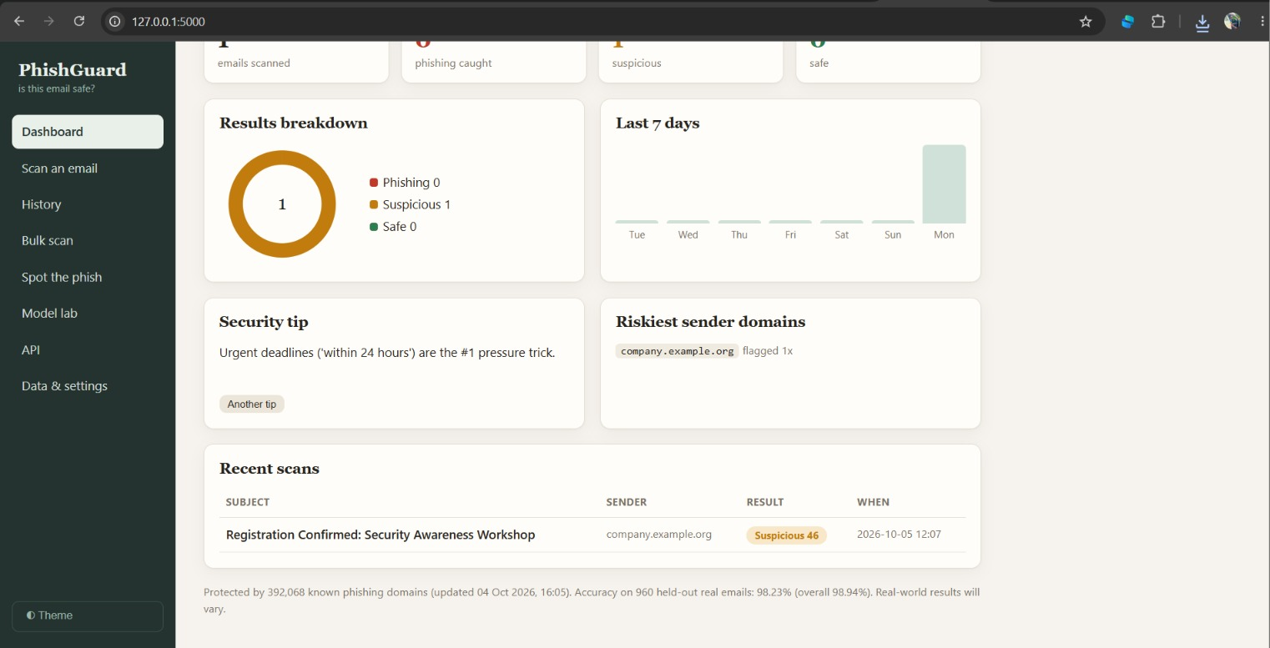
Fig. 2 — Dashboard (bottom): Recent scans activity log, riskiest sender domains, and security tip
12 / 30
Notes:
Top row is what the user does. The bottom row is how it is built: five modules, each with one job.

Slide 13
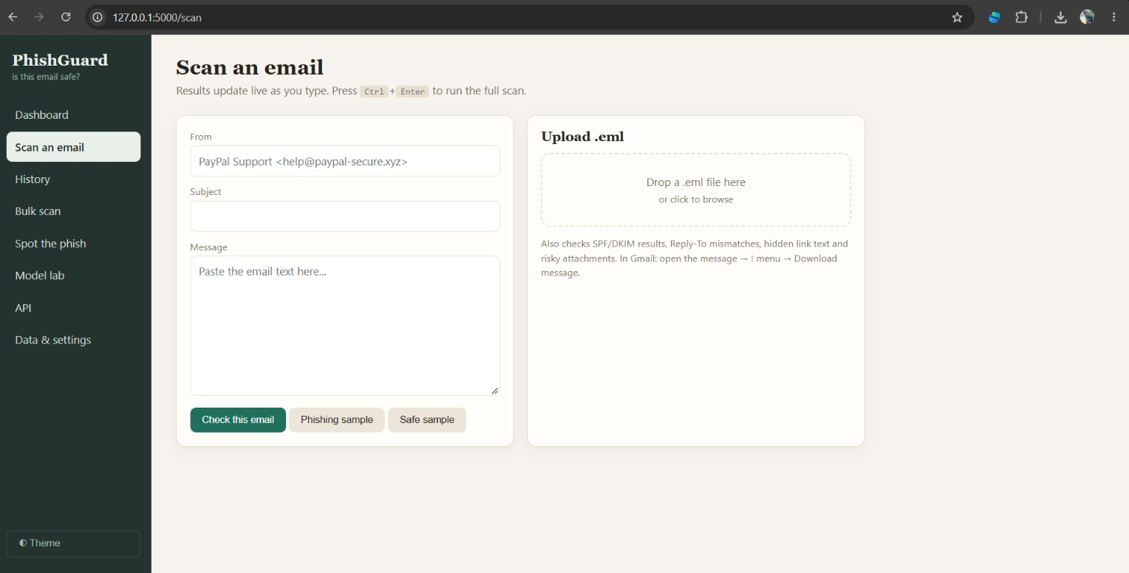
Fig. 3 — Scan an email: Single-email scan page with header/body input fields and .eml file upload
13 / 30
Notes:
Top row is what the user does. The bottom row is how it is built: five modules, each with one job.

Slide 14
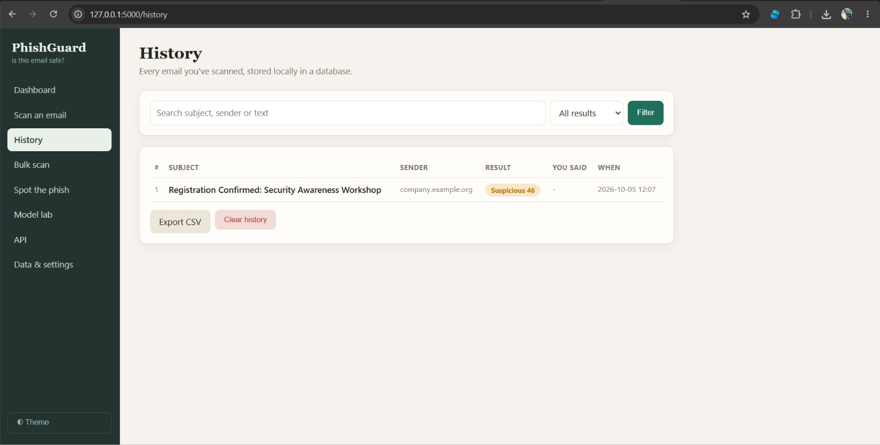
Fig. 4 — History: Searchable scan history database with filter controls and CSV export
14 / 30
Notes:
Top row is what the user does. The bottom row is how it is built: five modules, each with one job.

Slide 15
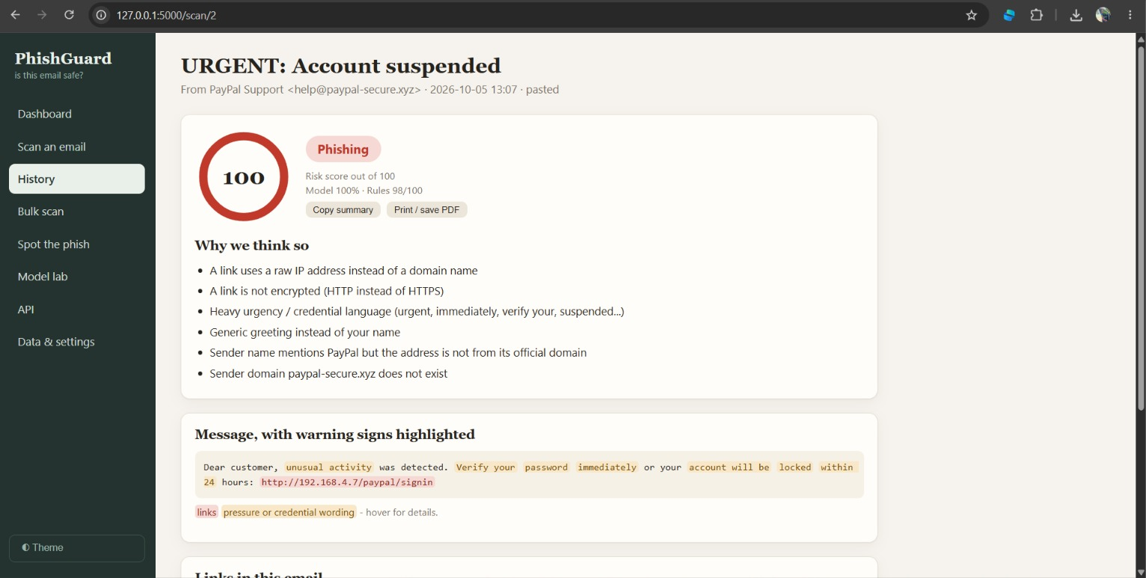
Fig. 5 — Result (Account suspended, Phishing 100): Scan result for a high-risk phishing email with score ring, heuristic explanations, and highlighted text
15 / 30
Notes:
Top row is what the user does. The bottom row is how it is built: five modules, each with one job.

Slide 16
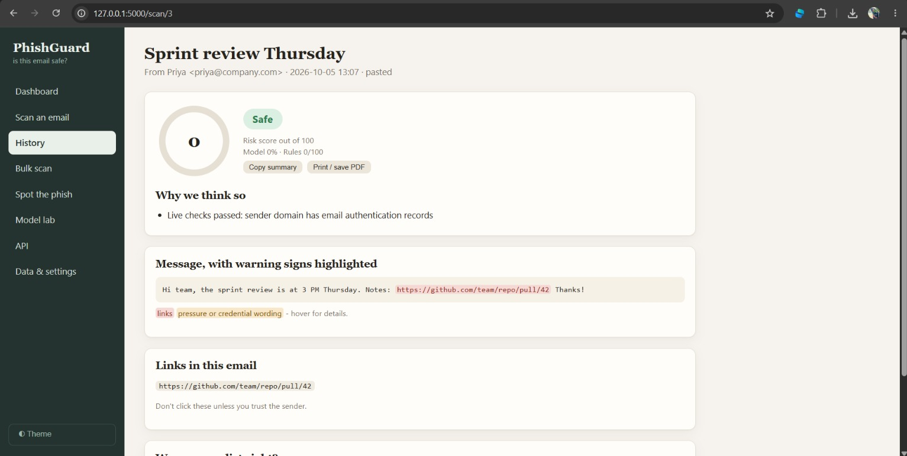
Fig. 6 — Result (Sprint review, Safe 0): Scan result for a benign corporate email with zero-risk score and passed domain checks
16 / 30
Notes:
Top row is what the user does. The bottom row is how it is built: five modules, each with one job.

Slide 17
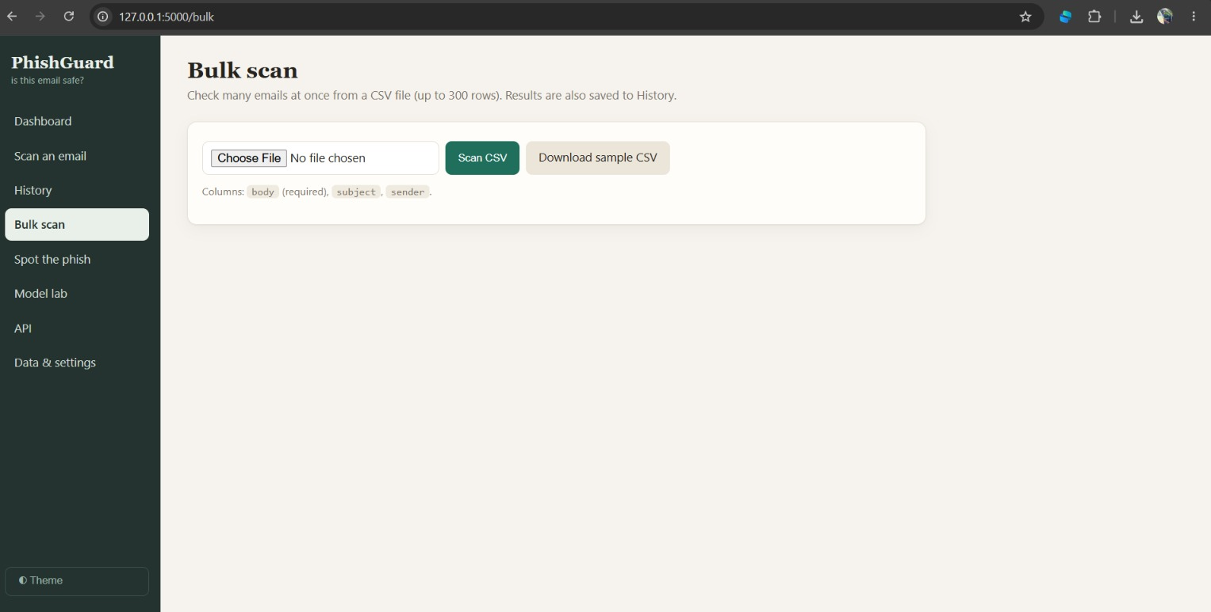
Fig. 7 — Bulk scan: Batch email processing page via CSV upload with downloadable sample template
17 / 30
Notes:
Top row is what the user does. The bottom row is how it is built: five modules, each with one job.

Slide 18
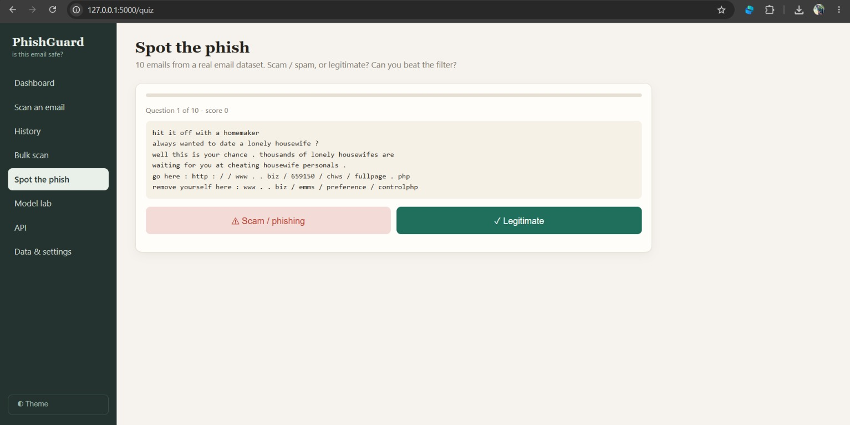
Fig. 8 — Spot the phish: Interactive security awareness quiz module built from real dataset emails
18 / 30
Notes:
Top row is what the user does. The bottom row is how it is built: five modules, each with one job.

Slide 19
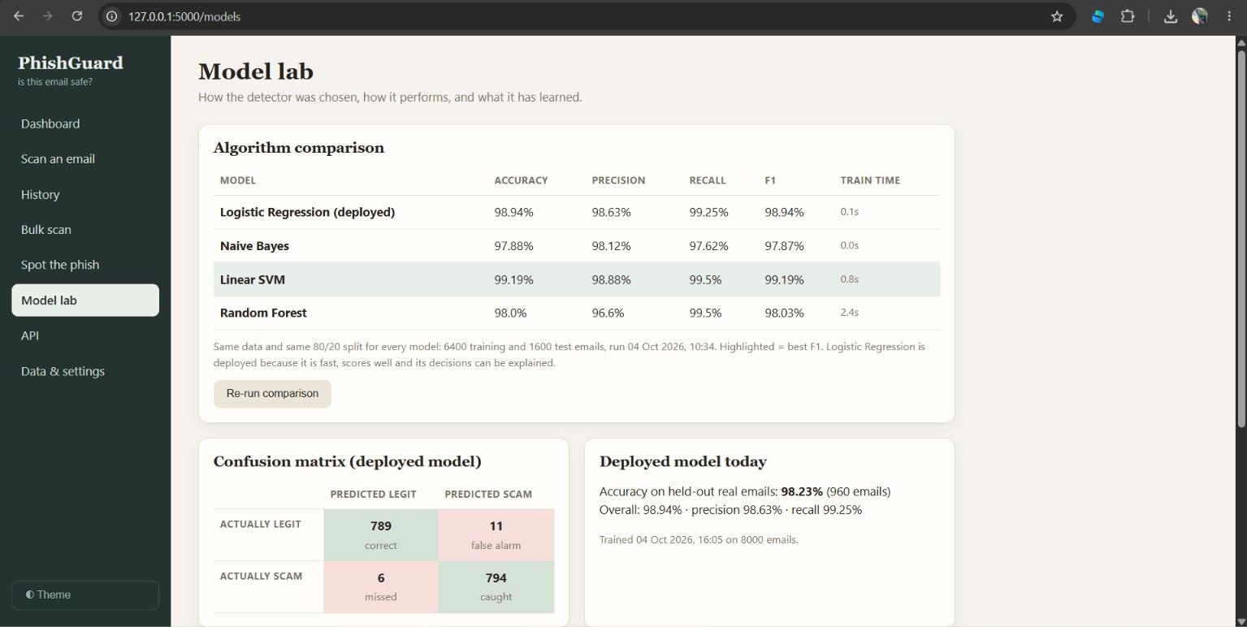
Fig. 9 — Model lab (benchmarks): Multi-algorithm comparison table (LogReg, SVM, Naive Bayes, RF) and confusion matrix
19 / 30
Notes:
Top row is what the user does. The bottom row is how it is built: five modules, each with one job.

Slide 20
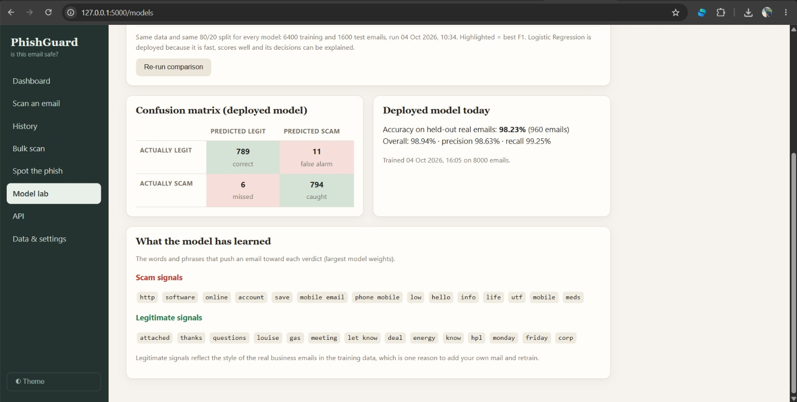
Fig. 10 — Model lab (feature weights): Explainable AI view showing top weighted scam signals vs. legitimate tokens
20 / 30
Notes:
Top row is what the user does. The bottom row is how it is built: five modules, each with one job.

Slide 21
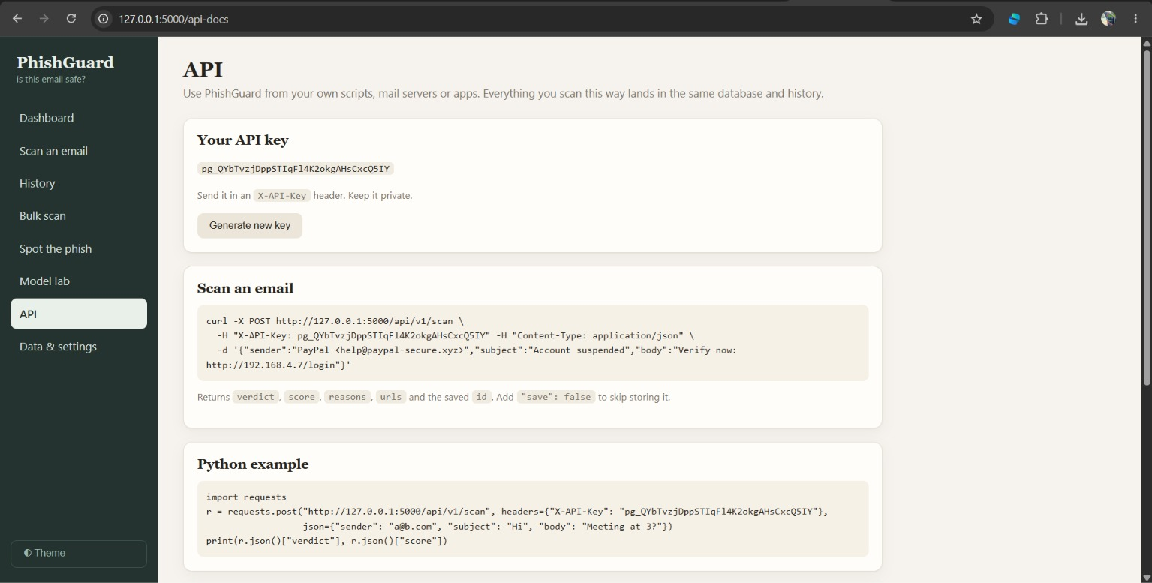
Fig. 11 — API: REST API documentation with key management, CURL commands, and Python code examples
21 / 30
Notes:
Top row is what the user does. The bottom row is how it is built: five modules, each with one job.

Slide 22
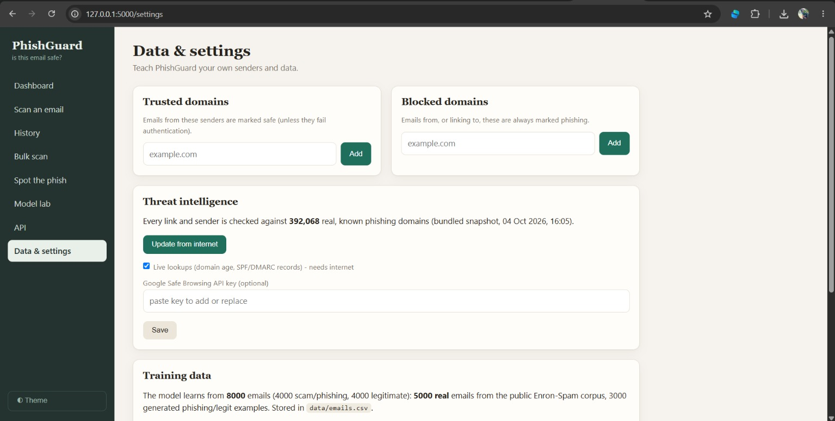
Fig. 12 — Data & settings (top): Configuration for trusted/blocked domain lists and threat intelligence feeds
22 / 30
Notes:
Top row is what the user does. The bottom row is how it is built: five modules, each with one job.

Slide 23
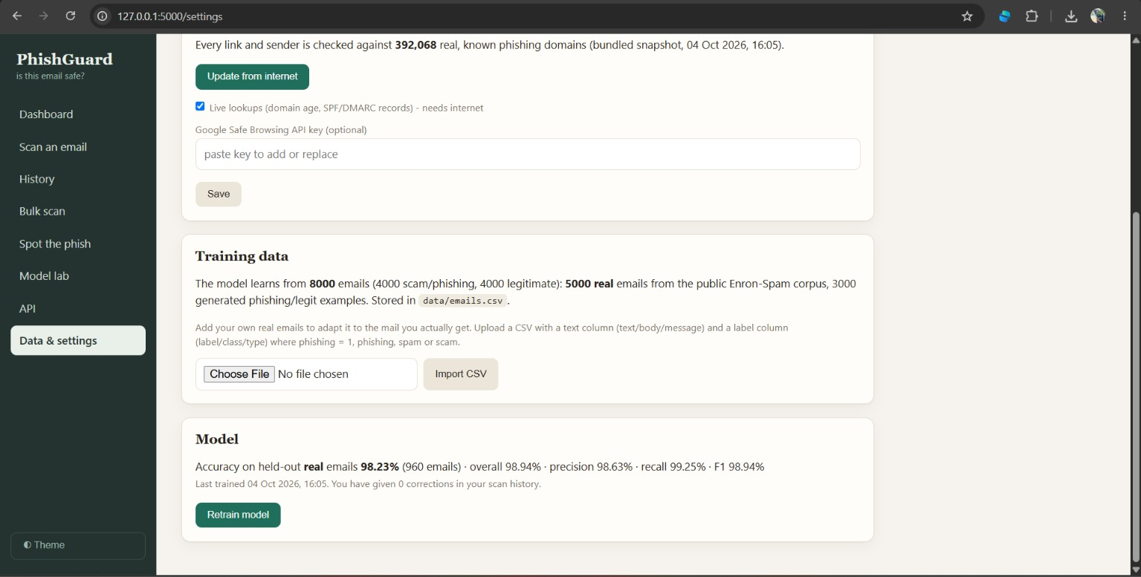
Fig. 13 — Data & settings (bottom): Training dataset management, Enron corpus statistics, and model retraining controls
23 / 30
Notes:
Top row is what the user does. The bottom row is how it is built: five modules, each with one job.

Slide 24
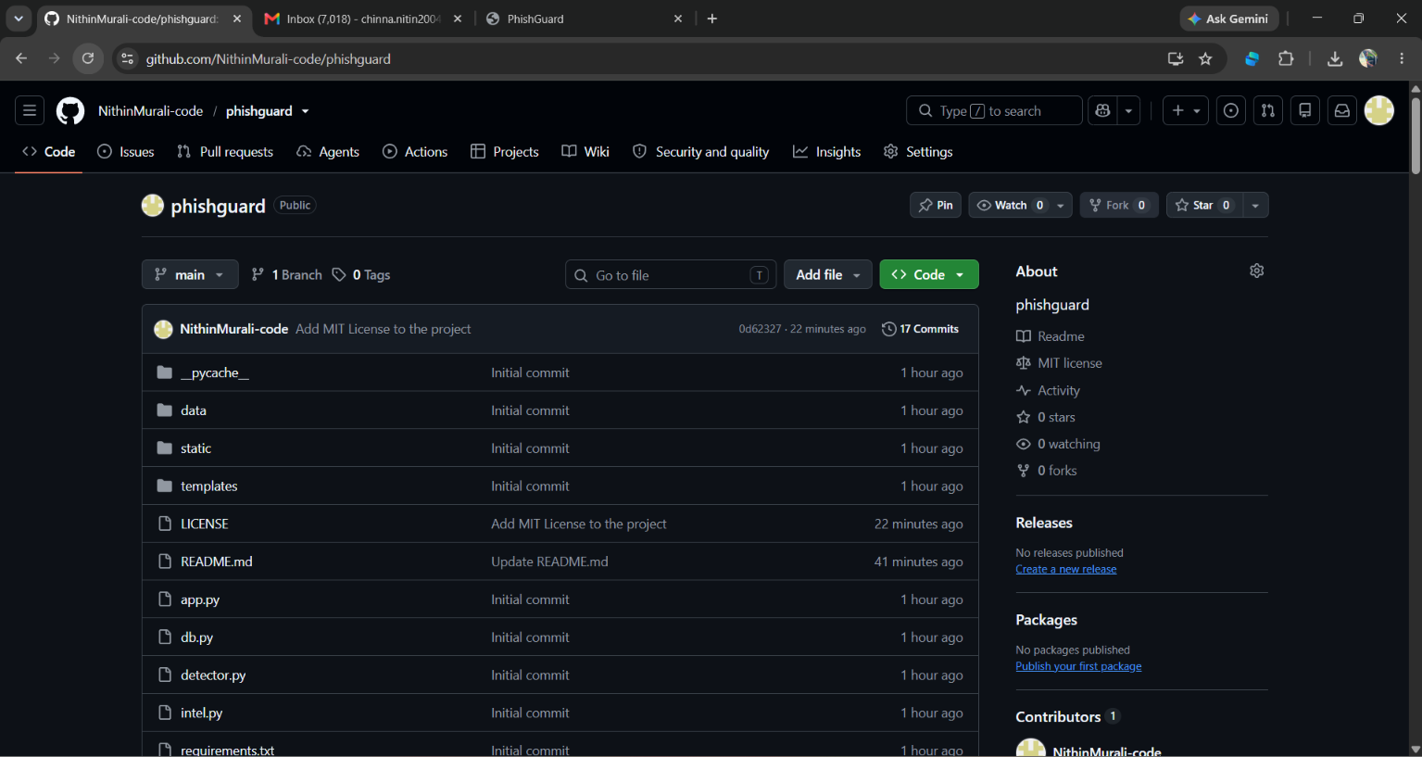
GITHUB REPOSITORY LINK
https://github.com/NithinMurali-code/phishguard.git
24 / 30
Notes:
Top row is what the user does. The bottom row is how it is built: five modules, each with one job.

Slide 25
// 11 TESTING AND EXPECTED RESULTS
What we measured
Test email
Expected
Observed
98.23%
98.94%
Fake PayPal mail: IP link, urgent wording
Phishing
Phishing 99
accuracy on 960 held-out real emails
overall accuracy on 1,600 test emails
Work email with a GitHub link
Safe
Safe 0
Casual lunch message
Safe
98.63%
99.25%
Safe 1
precision
recall
Lottery scam text with no link
Flagged
Suspicious 51
Sample end-to-end checks on the finished app. All pages and API endpoints also responded correctly in testing.
Measured on one corpus (Enron-Spam plus generated samples); real-world results will vary.
25 / 30
Notes:
Be upfront about limits: the accuracy figures come from held-out data in one corpus. The lottery text was flagged as Suspicious, not Phishing, because it has no link or sender signals. That is expected behaviour, and a good example of why scores come with reasons.

Slide 26


// 12 CONCLUSION
Accurate, explainable and easy to use
Hybrid by design
Model, rules and a real threat database cover each other's blind spots.
PhishGuard shows that phishing detection can combine machine learning, rules and real threat data in one explainable, practical tool.
A complete product
Database, API, history, bulk scan and feedback make it practical.
Honest about limits
98.23% on held-out real emails, with every verdict backed by reasons.
26 / 30
Notes:
Close with three takeaways: hybrid design, a complete product, and honesty about limits.

Slide 27

// 13 ADVANTAGES
Why PhishGuard stands out
Explainable
Hybrid accuracy
Built on real data
Every verdict lists its reasons, so users learn as they scan.
ML, rules and threat data cover each other's weak spots.
392,068 known phishing domains and 5,000 real emails.
Easy to run
Adapts to you
Extensible
A local web app that starts with one command.
Trusted and blocked lists plus feedback retraining.
REST API and bulk scanning fit into other tools.
27 / 30
Notes:
Six advantages. Lead with explainability: it is what separates this project from a plain classifier.

Slide 28
// 14 LIMITATIONS
What to keep in mind
LIMITATION
HOW IT IS ADDRESSED
Trained on Enron-Spam (mostly spam, older mail) plus generated samples
Import real phishing datasets and retrain
Accuracy measured on one corpus; real-world results will be lower
Test on fresh mail and use feedback to adapt
English-language text only
Add Hindi and Telugu training data
Live checks need internet and third-party services
Each check fails safe; the offline database always works
Attachment contents are not scanned; single-user local app
Risky file types are flagged; hosted version planned
28 / 30
Notes:
Be candid. Naming limits and how to address them shows maturity and heads off the toughest questions.

Slide 29








// 15 LEGAL AUTHORITY AND DISCLAIMERS
Educational use only: use it responsibly
Educational use only
Scan only with authority
A student project for learning and demonstration. It is not a certified or commercial security product.
Use it on your own emails or with the mailbox owner's clear permission. Reading others' mail without it may be illegal.
Respect privacy
No guarantee of accuracy
Emails hold personal data. Never store or share others' messages without consent, and obey data-protection laws.
Results are risk estimates and can be wrong in both directions. Never rely on them alone for security decisions.
No illegal use
Third-party data and services
Do not use it to build, test or send phishing, or to attack, scam or harass anyone.
The threat feed, Enron-Spam data and optional lookup services keep their own licences and terms. Follow them.
Provided as is
Not legal advice
Shared under the MIT licence with no warranty. The author is not liable for losses or misuse.
Laws differ by country (in India: IT Act, 2000 and DPDP Act, 2023). Check local rules or ask a qualified professional.
29 / 30

Slide 30



// 16 FUTURE SCOPE
Where PhishGuard goes next
NEAR TERM
MID TERM
LONG TERM
More real phishing data
SMS and QR scanning
Deep learning
Train on large phishing corpora.
Reuse the engine for scam texts and QR codes.
Compare transformer models such as BERT.
Inbox integration
Hindi and Telugu
Cloud deployment
Gmail and Outlook plugins.
Detect scams in regional languages.
Hosted version with user accounts.
Thank you | Questions?
30 / 30
Notes:
Roadmap in three phases. The most valuable next step is training on larger real phishing datasets. Then thank the audience and invite questions.

